Slide 1

Electronic Sales Analysis
Jatin Naresh Dolas
Data Analyst

Slide 2
Agenda
Introduction
Data Processing
Data Visualization
Insights
Conclusion
Presentation Title

Slide 3

Introduction
Electronic Sales Analysis involves the comprehensive examination of the purchases of electronic devices, equipment, and accessories made over a period of 12 months from retail stores located in various regions throughout the United States of America.

Slide 4
Data Processing
Processing Data : Workflow Steps
I used the Python tool its libraries to process the data like Pandas, OS, and NumPy.
Merged 12 csv files into single csv file.
Dropped all null values and removed columns from data frame.
Augmented the data with additional columns like Month, Sales, and City.

Slide 5

Data Visualization
Graphical Representations in upcoming slides

Slide 6
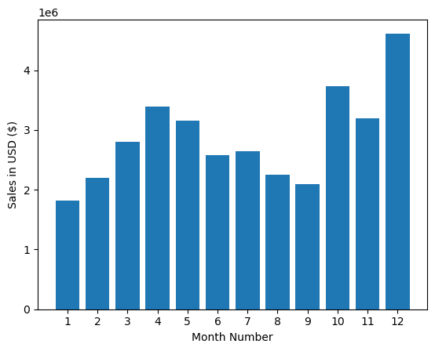
Q.1) What was the best month for Sales? How much was earned that month?
Notes:
Q.1) What was the best month for Sales? How much was earned that month?
a) Sales in January month is worse than December month and there is slight improvement in month of April.
b) We like to spend more money on Advertisement like in months of April and December.
c) In the month of December, there are holidays like Christmas and New Year Eve, and everybody buys gift for each other.

Slide 7
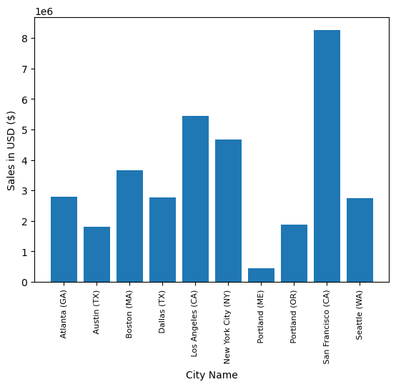
Q.2) What city had the highest number of Sales?
Notes:
Q.2) What city had the highest number of Sales?
a) San Francisco is city which have the big market for Electronics sales and advertising there will benefit a lot.
b) Silicon Valley's location in the San Francisco area contributes to its strong electronics market.
c) On the other hand, Portland, Maine, has the smallest electronics market among all US cities.

Slide 8
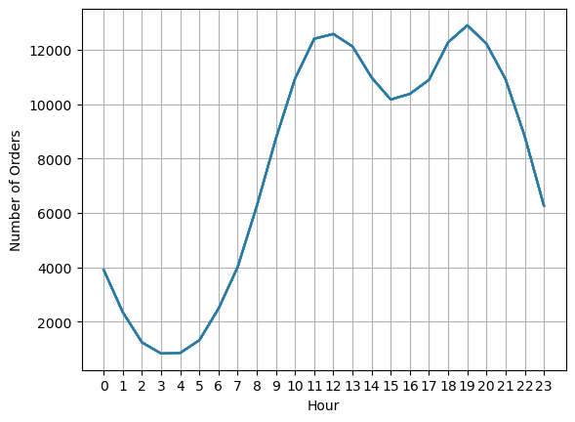
Q.3) What time should we display advertisements to maximize the likelihood of customer’s buying product?
Notes:
Q.3) What time should we display advertisements to maximize the likelihood of customer’s buying product?
a) Data analysis reveals two main peaks in customer orders: around 11 a.m. and 7 p.m.
b) These times coincide with morning and post-work activities.
c) To maximize advertising effectiveness, consider targeting ads just before 11 a.m., around 12 p.m., and at 6 p.m. or 7 p.m.
d) Segmenting data by specific cities could offer additional insights for tailored advertising strategies.

Slide 9
Q.4) What products are most often sold together?
Products | Sales
iPhone and Lightning Charging Cable | 1005
Google Phone and USB-C Charging Cable | 987
iPhone and Wired Headphones | 447
Google Phone and Wired Headphones | 414
Vareebadd Phone and USB-C Charging Cable | 361
iPhone and Apple Air pods Headphones | 360
Google Phone and Bose SoundSport Headphones | 220
USB-C Charging Cable and Wired Headphones | 160
Vareebadd Phone and Wired Headphones | 143
Lightning Charging Cable and Wired Headphones | 92
Notes:
Q.4) What products are most often sold together?
a) To identify common sets of three items, start by analyzing data for pairs.
b) Utilize this insight to create more intelligent promotions for business.
c) For example, when selling an iPhone, offer bundle deals that include related items like a lightning charging cable to attract a wider audience.
d) Use this data strategically to inform business decisions and boost sales.

Slide 10
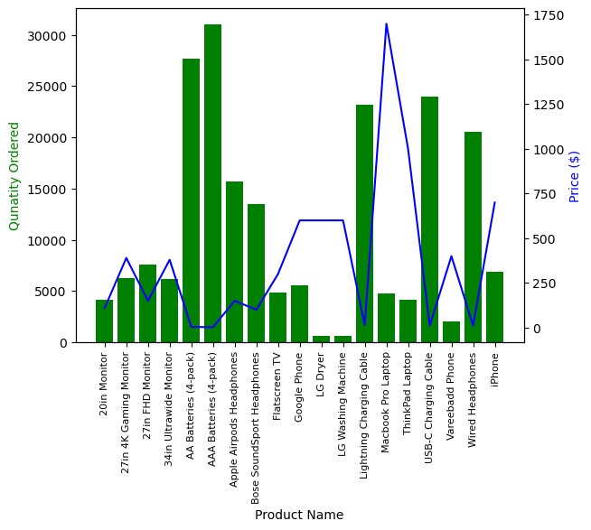
Q.5) What product sold the most? Why do you think it sold the most?
Notes:
Q.5) What product sold the most? Why do you think it sold the most?
a) High demand for triple-A and double-A batteries and electronic accessories (e.g., Lightning and USB-C cables) drives their high quantity ordered.
b) Expensive products like the LG dryer have lower demand due to their price.
c) Popular items like MacBooks and ThinkPad laptops see high quantities ordered, primarily because of their widespread appeal, especially among students.

Slide 11
Insights
Q.1) What was the best month for Sales? How much was earned that month?
Sales in January month is worse than December month and there is slight improvement in month of April.
We like to spend more money on Advertisement like in months of April and December.
In the month of December, there are holidays like Christmas and New Year Eve, and everybody buys gift for each other.
Q.2) What city had the highest number of Sales?
San Francisco is city which have the big market for Electronics sales and advertising there will benefit a lot.
Silicon Valley's location in the San Francisco area contributes to its strong electronics market.
On the other hand, Portland, Maine, has the smallest electronics market among all US cities.

Slide 12
Insights
Q.3) What time should we display advertisements to maximize the likelihood of customer’s buying product?
Data analysis reveals two main peaks in customer orders: around 11 a.m. and 7 p.m.
These times coincide with morning and post-work activities.
To maximize advertising effectiveness, consider targeting ads just before 11 a.m., around 12 p.m., and at 6 p.m. or 7 p.m.
Segmenting data by specific cities could offer additional insights for tailored advertising strategies.
Q.4) What products are most often sold together?
To identify common sets of three items, start by analyzing data for pairs.
Utilize this insight to create more intelligent promotions for business.
For example, when selling an iPhone, offer bundle deals that include related items like a lightning charging cable to attract a wider audience.
Use this data strategically to inform business decisions and boost sales.

Slide 13
Insights
Q.5) What product sold the most? Why do you think it sold the most?
High demand for triple-A and double-A batteries and electronic accessories (e.g., Lightning and USB-C cables) drives their high quantity ordered.
Expensive products like the LG dryer have lower demand due to their price.
Popular items like MacBooks and ThinkPad laptops see high quantities ordered, primarily because of their widespread appeal, especially among students.

Slide 14
Thank you
Jatin Naresh Dolas
jatindolas18@gmail.com
github.com/JatinD18

